Slide 1
0/1 knapsack problem using Branch and Bound

Slide 2
The 0/1 knapsack problem
 Positive integer P₁, P₂, …, P_{n} (profit)
W₁, W₂, …, W_{n} (weight) M (capacity)
n
maximize ∑ P_{i} X_{i}
i=1
subject to ∑ W_{i} X_{i} ≤ M
i=1
The problem is modified:
n
X_{i} = 0 or 1, i =1, …, n.
n
minimize
∑ P_{i} X_{i} i=1
53

Slide 3
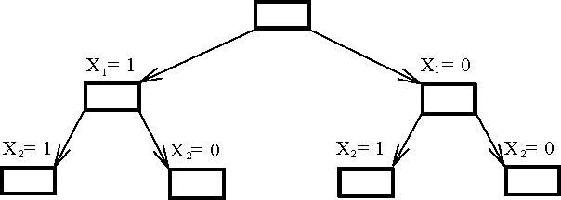
The 0/1 knapsack problem
The Branching Mechanism in the Branch-and-Bound Strategy to
Solve 0/1 Knapsack Problem.
54

Slide 4
How to find the upper bound?
Ans: by quickly finding a feasible solution in a greedy manner: starting from the smallest available i, scanning towards the largest i’s until M is exceeded. The upper bound can be calculated.
55

Slide 5
How to find the ranking Function
Ans: by relaxing our restriction from X_{i} = 0 or 1 to 0 ≤ X_{i} ≤ 1 (knapsack problem)
n
Let − ∑ P_{i} X_{i}
i=1
knapsack problem and
be an optimal solution for 0/1
n
∑ P_{i} X ′ _{i}
be an optimal
i=1
solution for fractional knapsack problem. Let
n n
Y= − ∑ P_{i} X_{i} , Y’ =
i=1
⇒ Y’ ≤ Y
∑ P_{i} X′_{i} .
i=1

Slide 6
How to expand the tree?
By the best-first search scheme
That is, by expanding the node with the best lower bound. If two nodes have the same lower bounds, expand the node with the lower upper bound.
57

Slide 7
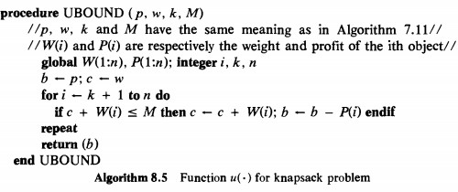
0/1 Knapsack algorithm using BB

Slide 8
0/1 Knapsack Example using LCBB (Least Cost)
Example (LCBB)
Consider the knapsack instance:
 n = 4;
 (pi, p2, p3, p4) = (10, 10, 12, 18);
 (wi. w2, w3, w4) = (2, 4, 6, 9) and  M = 15

Slide 9
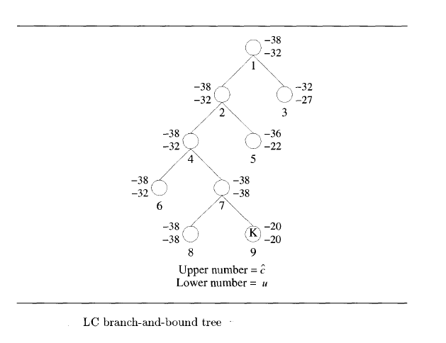
0/1 Knapsack State Space tree of Example using LCBB
‘u’ without fraction
‘c’ with fractions
(pi, p2, p3, p4) = (10, 10, 12, 18)
(wi. w2, w3, w4) = (2, 4, 6, 9)
M = 15

Slide 10
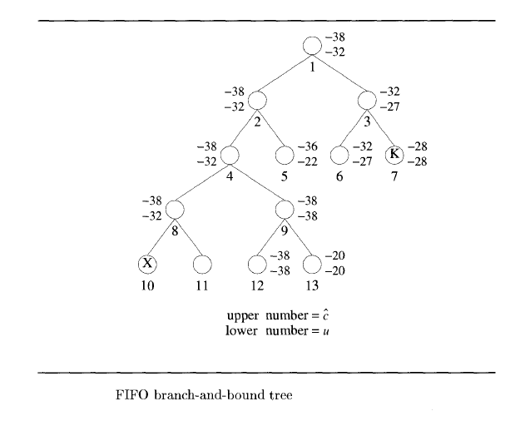
0/1 Knapsack State Space tree of Example using FIFO BB

